Slide 1
Ways to prevent violence at school
Emma Stoitsova

Slide 2
Violence in schools is one of the most visible forms of violence against children. Violence in schools can take many forms, ranging from physical violence to psychological violence. It is often expressed through acts of bullying, intimidation and repression. Violence in schools creates insecurity and fear which harm the general school climate and infringe pupils’ right to learn in a safe, unthreatening environment. Schools cannot fulfil their role as places of learning and socialisation if children are not in an environment free of violence.

Slide 3
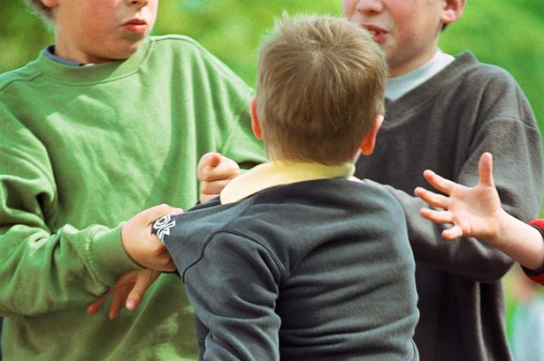

Slide 4
All schools work to prevent school violence and schools are very safe places. Students, staff, and parents all have an important role in promoting school safety. Adults can provide leadership by reassuring students that schools are generally very safe places for children and youth and reiterating what safety measures and student supports are already in place in their schools.

Slide 5
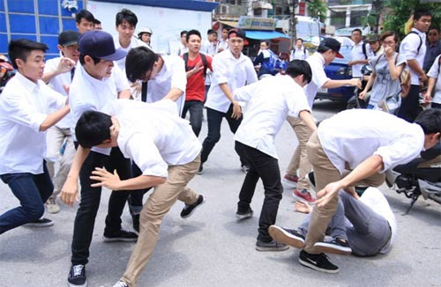

Slide 6
Ways to prevent the school violence
1. Teach social and emotional skills
2. Use technology to identify troubled students
3. Enlist social media companies in the effort to detect threats
4. Think critically about your child’s social media use

Slide 7
5. Talk with your child

Slide 8
Thank you for the attention!

